Slide 1
Database Change Management
Boston Code Camp – October 2013
Andrew Babiec
ababiec@tallan.com
2013-10-19

Slide 2
Difficulties in managing Database Changes
Databases are inherently stateful
Not integrated in the ALM lifecycle
Production database, not source control, is “Master”
Stability/conflict issues due to using centralized database for development
Coordinating changes from multiple teams
Lack of tooling for developers
Notes:
SQL Server has always been lacking in a good solution to control versions of your database. We make changes directly to the database and if we're good, we remember to take backups. If we're really good, we save scripts so we can make those changes elsewhere. Too often, we resort to tools for schema differences or try to save up all of the scripts to replay them later. Both have some advantages. Schema differences guarantee that you can make two environments look the same. Scripts can be replayed in order to keep the systems in sync. However, a schema difference doesn't handle data changes well and can't handle making partial changes when not everything is ready to promote. Sets of scripts can also work well, but fail if you end up needing to push sub-sets of those scripts because certain functionality isn't going to be released yet.
Databases are inherently stateful
ALTERs are generally run instead of DROP/CREATE
Alter/Reorg scripts are throw away code. Some complex enough to require days to write. Many routine / monotonous work.
Dependencies can greatly complicate the changes and scripts
Change accumulation / management is hard.
Data needs to be persisted
Databases are often not integrated well with the application development life cycle
DB Versions are frequently not persisted or managed well
SQL Scripts may not handle different SQL Server versions well

Slide 3
Sequential Changes vs. Declarative Model
Sequential
Run multiple scripts over time to achieve desired end state
Manual process
Point in time model
Declarative
The model is the desired end state
Generated / Programmatic process
Always current
Notes:
Sequential Change Scripts
Required to run in a set order
Script 1, Script 2, Script 3, …
Can't do Script 1, Script 4, Script 9
Validating the end state after script runs vs. an expected end state can be complex
Could easily miss a script in the sequence without knowing
Handling a release where scripts need to be "skipped" can cause cascading dependency problems
Can require extensive use of IF NOT EXISTS statements
Manual process
Point in time model
Used by systems such as DBDiff
Declarative Model
In addition to bringing the aforementioned new features, SSDT pushes a new development paradigm: the notion of declarative database development. Put simply, declarative database development means that you define within SSDT what your schema looks like. Then, when you deploy (or in SSDT parlance, publish) your SSDT project to a target database, SSDT will determine what it needs to do to make your target look like the schema that you've defined.
The model is the desired end state
Compare the current state of the target against the desired end state
Use the differences to generate an upgrade plan
Use the upgrade plan to generate a change script, correctly ordered to bring the target up to the desired end state
Generated / Programmatic process
Always current
Used by Red Gate, Microsoft, DB Ghost

Slide 4
SQL Server Data Tools (SSDT)
Visual Studio 2010/2012 add-in, built into 2013
Provides tools to design, edit, build and deploy Database Schema artifacts
For developers and DBA’s
Not to be confused with SQL Server Data Tools - Business Intelligence (SSDT-BI.)
VS2012 replacement for Business Intelligence Development Studio (BIDS) SSAS, SSIS, SSRS
Notes:
SQL Server Data Tools (SSDT) is an add-on to Visual Studio 2010/2012 that provides the ability to design, edit, build and deploy Database Schema artifacts. It is a replacement for the Database Projects previously found in Visual Studio 2005, 2008 and 2010.
SSDT is an attempt to bring similar tools and consistency to SQL Server development to what .NET developers have had for years. Features such as IntelliSense, code refactoring, code navigation, find all references, sandboxed development and deployment, MSBuild support, and ease of deployment will be familiar to most .NET developers.
This tool should not be confused with another similarly named tool: SQL Server Data Tools - Business Intelligence (SSDT-BI.) The latter is the Visual Studio 2012 replacement for the Business Intelligence Development Studio (BIDS) and provides project templates for Analysis Services, Integration Services, and Reporting Services projects.
This tool should not be confused with another similarly named tool: SQL Server Data Tools - Business Intelligence (SSDT-BI.) The latter is the Visual Studio 2012 replacement for the Business Intelligence Development Studio (BIDS) and provides project templates for Analysis Services, Integration Services, and Reporting Services projects

Slide 5
How to use SSDT?
Import
Build
Refactor
Compare
Deploy

Slide 6
Import
Import from…
Database (one time)
.DACPAC file (one time)
.SQL Script
Or just add items manually
Unlike prior DB Projects, solution structure does not matter

Slide 7
Building and debugging
Compilation - MSBuild
Target Platform
Resolve warnings and errors
Output: .DACPAC file
Optional: SQL file
Debugging & (localdb)
Start with Project or
Code Analysis

Slide 8
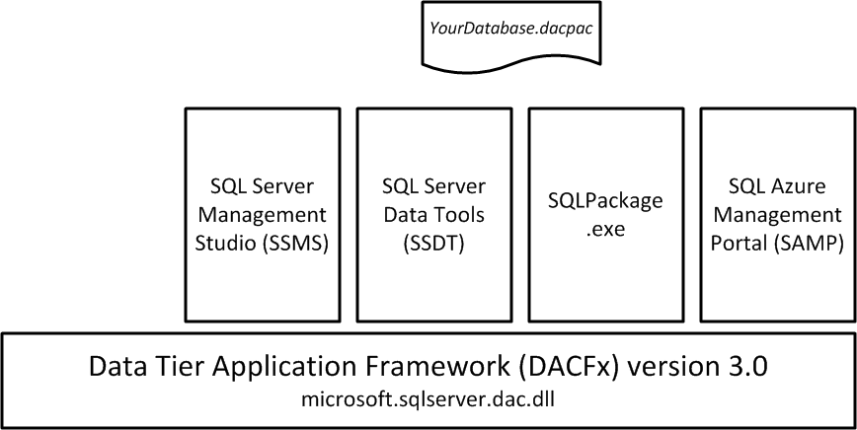
Data Tier Applications (DAC)
DacFx framework
DACPAC vs. BACPAC?
Including data in an extract
Register vs. Publish
SSDT and DacFx updates

Slide 9
Developer Productivity
Refactoring
Go to Definition / Find all references
IntelliSense
Table Designer
SQL Object Explorer
Query Editor
Unit Testing

Slide 10
Schema Compare
Source or Target can be Project or Database or DACPAC
Group results by Action, Schema or Type
Can update Target or create SQL Script

Slide 11
Deployment Options
From Visual Studio project
Using SQL Server Object Explorer
MSDeploy
Command line: SQLPackage.exe
Publish Profile and saved settings
SQL Script (with the corresponding pros and cons)
Notes:
c:\Program Files (x86)\Microsoft SQL Server\110\DAC\bin\SqlPackage.exe" /action:driftreport /TargetConnectionString:"Data Source=VSALM;Initial Catalog=TradeDEV;Integrated Security=True;Connect Timeout=15;Encrypt=False;TrustServerCertificate=False" /OutputPath:"c:\util\report.txt“

Slide 12
Deployment Topics
Handling Rollbacks
Drift Detection
Versioning
Pre-deploy and post-deploy scripts

Slide 13
Other Features
Server-level objects
Database References and Linked Servers
MASTER and MSDB references
Server Variables
Composite projects
Snapshot
Project and Item Templates

Slide 14
Additional items of note
Importance of using Refactoring vs. Edits
Publish vs. Import
Publish vs. Generate Script
Generate Script vs. Schema Compare
Build vs. Publish vs. Snapshot vs. Debug vs. Extract

Slide 15
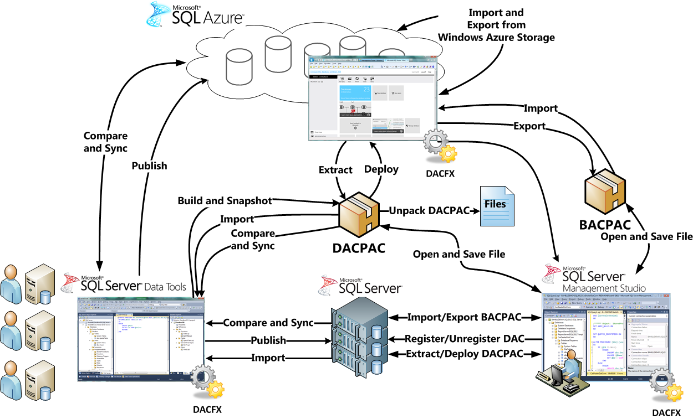
Big Picture

Slide 16
Issues
Cleaning up legacy code
Handling artifacts from code generation tools
Lack of filtering options in import/compare
Replication
Circular database references
Lack of EF integration
Refactoring does not extend into SQL embedded in your C# code

Slide 17
SSDT Compared to VS Database Projects
SSDT
Supports SQL 2005 – 2012
Offline table designer and debugging
VSDB
Server project types
Non-SQL Server support
Data Generation
Requires VS 2010 Premium or Ultimate
Does not support VS 2012 or 2013

Slide 18
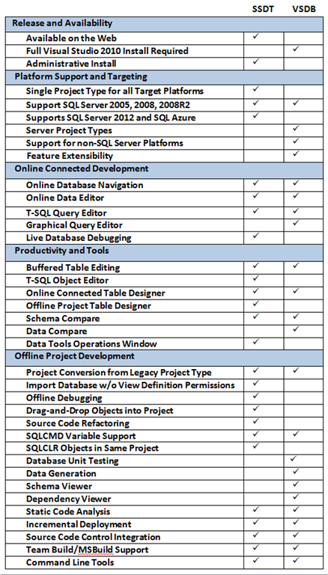
SSDT vs. VSDB
Image outdated, SSDT now includes unit tests, data compare and extensibility

Slide 19
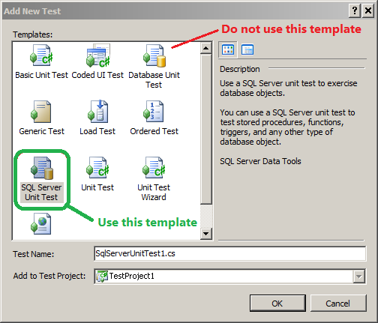
SSDT unit tests vs. VSDB unit tests

Slide 20
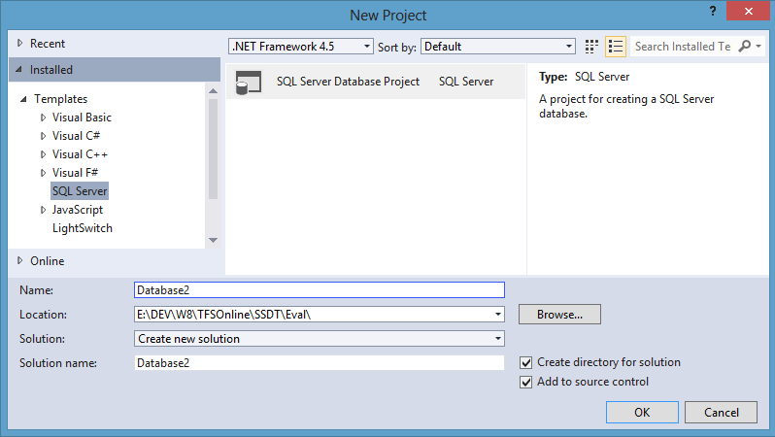
SSDT project template

Slide 21
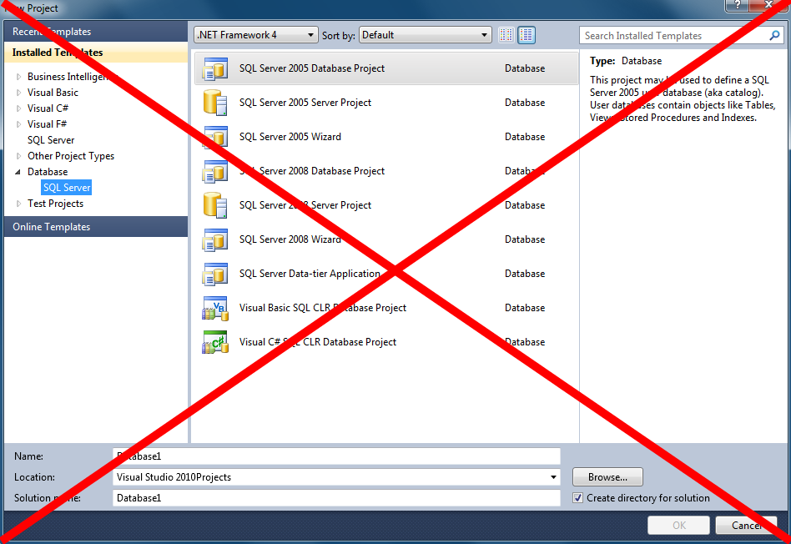
VSDB project templates

Slide 22
More Info
Contact Info:
ababiec@tallan.com , @ababiec
MSDN, Blog, Forums
http://msdn.microsoft.com/en-us/data/tools.aspx
This presentation
http://sdrv.ms/1cF8Clg

